Slide 1
PSD 2 – Use Cases
Global Payments Practice
Date – June 2016

Slide 2
Coverage
Introduction to PSD2 and Project Background
Snapshot of Business Scenario
PISP Scenarios
Scenario 1 – Merchant Bank as PISP
Scenario 2 – TPP as PISP
Scenario 3 – Merchant (TPP) as PISP
Scenario 4 – Bank (AS-PSP) to TPP Money Transfer
Scenario 4.1 – Alternative approach based on other RTP schemes
Scenario 5 – TPP to Bank (AS-PSP) Money Transfer
Scenario 5.1 – Alternative approach based on other RTP schemes
Scenario 6 – TPP to TPP Money transfer
Scenario 6.1 – Alternative approach based on other RTP schemes
AISP Scenarios
Scenario 7 – Bank as AISP
Scenario 8 – TPP as AISP
PISP Scenarios for Direct Debit
Scenario 9 – Mandate is maintained and managed by Merchant Bank
Scenario 9.1 - Mandate is maintained and managed by PISP

Slide 3
Introduction to PSD2
The Payment Services Directive (PSD) was adopted by the European Union (EU) in 2007. The aim of this directive was to regulate the payments industry and to increase pan-European competition and participation in the payments industry also from non-banks, and to provide for a level playing field by harmonizing consumer protection and the rights and obligations for payment providers and users.
Due to rapid changes in payments landscape, it was required to impart clarity and drive further innovation, competition and transparency in payment services, hence a revised directive (PSD2) has been adopted on October 2015.
PSD2 defines traditional financial institutions as “account servicing payment service providers”ii (AS PSP), and new players as “Payment Initiation Service Providers” (PISP) and “Account Information Service Providers”(AISP). These service provider may be Banks or Third Party Providers. Bank or TPP may provide both of these services.
The classification of PISP is meant to target “payment initiation services [that establish] a software bridge between the website of the merchant and the online banking platform of the payer’s bank in order to initiate internet payments on the basis of a credit transfer”.
The introduction of PISPs changes the current 4-corner payments model into a 5-corner model. Rather than the payer initiating the payment directly with their Account Servicing PSP, the payer initiates the payment via the PISP, which in turn passes the instruction to the Account Servicing PSP.

Slide 4
PSD2 Role, Entity and their Definition
PISP – Payment Initiation Service Provider
This is new entity introduce as a part of PSD2. Role of PISP can be performed by any Bank, Third Party Service Provider or Merchant. PISP initiate only online banking e-Payment and doesn’t cover any kind of Card Payment.
AISP – Account Information Service Provider
This is new entity introduce as a part of PSD2. Role of PISP can be performed by any Bank or Third Party Service Provider. AISP provider get bank account details of a customer from different bank and show it to customer.
AS-PSP – Account Servicing Payment Service Provider
AS-PSP is an entity which maintains customer account. AS-PSP is mainly performed by Banks.
TTP – Third Party Provider
Third Party Provider is new entity as a part of PSD2 and will be performing role of PISP and AISP. TPP is mainly Payments gateway, Wallets, Merchants.
CSM – Clearing and Settlement Mechanism
CSM is mainly involved in clearing and settlement of the funds for the transaction initiated by PISP. It is mainly available system to clear the funds. In SEPA region it will be mostly SCT/SDD, and Sepa Insta Payment in near future.
Entity | Roles
Bank | PISP, AISP, AS-PSP
TPP | PISP, AISP
Merchant | PISP
CSM | Clearing & Settlement, Third Party Registry Services

Slide 5
Snapshot of Business Scenarios

Slide 6
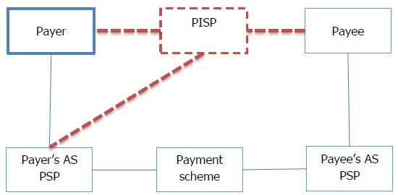
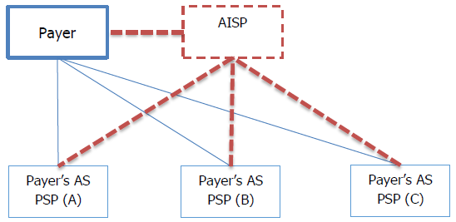

PISP & AISP Overview
PISP – Payment Initiation Service Provider
AISP – Account Information Service Provider
Customer
(Bank / TPP)
Merchant
(Bank / TPP)
Customer
Note: A payer not necessarily needs to have bank accounts at multiple banks.

Slide 7
AS-PSP’s Compliance Scenario to support PISP and AISP
Payer Customer
Mandatory Functionality/APIs for AS-PSP to comply for PISP request
verifyCustomerLoginDetails
checkMerchantCreditDetails
verifyTransactionAndOTPDetails
executePaymentOrder
sendPaymentOTPToCustomer
notifyPaymentOrderStatus
AS-PSP APIs to support PISP Request
Support PISP
Bank / TPP providing PISP Services
Payer AS-PSP (B)
(Bank)
Payee Customer
Payer Customer
Payer AS-PSP (A)
(Bank)
AS-PSP APIs to support AISP Request
Mandatory Functionality/APIs for AS-PSP to comply for AISP request
verifyAccountInfoRequest
SendAccountInfo
Support AISP
Bank / TPP providing AISP Services
Payer AS-PSP (B)
(Bank)
Payer AS-PSP (C)
(Bank)
Note: In PSD2, it will not be mandatory for Bank to play role of PISP or AISP. But it will be mandatory for Banks to play role of AS-PSP and support PISP and AISP activities performed by different Third Party Provider or other Banks.

Slide 8
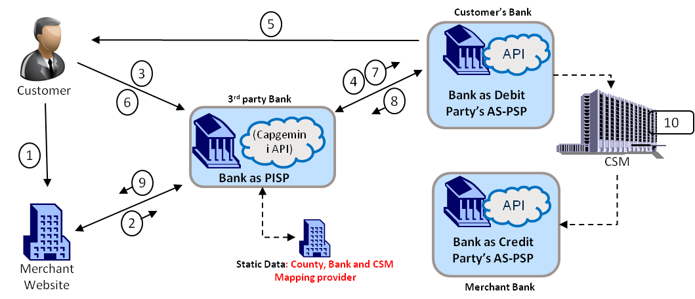

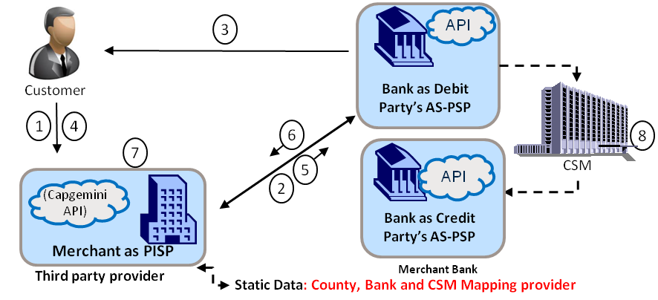
Snapshot of Business Scenarios for Banks acting as AS-PSP to comply with PSD2 regulations
Can be Camt.036 (DebitAuthorisationResponse)
All Banks has to implement these for it to be PSD2 compliant
*Can be Camt.036 (DebitAuthorisationResponse)*
Scenario 1
Scenario 2
Pacs.008
Pacs.008
Pain.001
Pain.001
Pacs.002
Pain.002
Pacs.002
Pain.002
Camt.060 – request
Camt.052/53 - response
Pacs.008
Camt.060 – request
Camt.052/53 - response
Pacs.008
Scenarios to handle PISP request
Pacs.008
Mandatory Functionality/APIs
verifyCustomerLoginDetails
checkMerchantCreditDetails
verifyTransactionAndOTPDetails
executePaymentOrder
sendPaymentOTPToCustomer
notifyPaymentOrderStatus
Pacs.002
Pain.001
Pacs.008
These 3 Scenarios are mandatory Scenarios that every bank has to cover under PSD2.
Scenario 3
Note: Functionalities/APIs are covered in detail in subsequent slides
*Can be Camt.036 (DebitAuthorisationResponse)*

Slide 9
Snapshot of Business Scenarios for Banks/TPP acting as PISP to comply with PSD2 regulations
All Banks has to implement these for it to be PSD2 compliant
Scenario 1
Scenario 2
Scenarios to handle PISP request
Mandatory Functionality/APIs
getMerchantCreditDetails
getMemberState&Bank
enterPaymentOTPDetails
sendCustomerLoginDetails
sendMerchantCreditDetails
sendTransactionAndOTPDetails
showPaymentsStatus
These 3 Scenarios are mandatory Scenarios that every bank or TTP that wants to play the role of PISP has to cover under PSD2.
Scenario 3
Note: Functionalities/APIs are covered in detail in subsequent slides

Slide 10
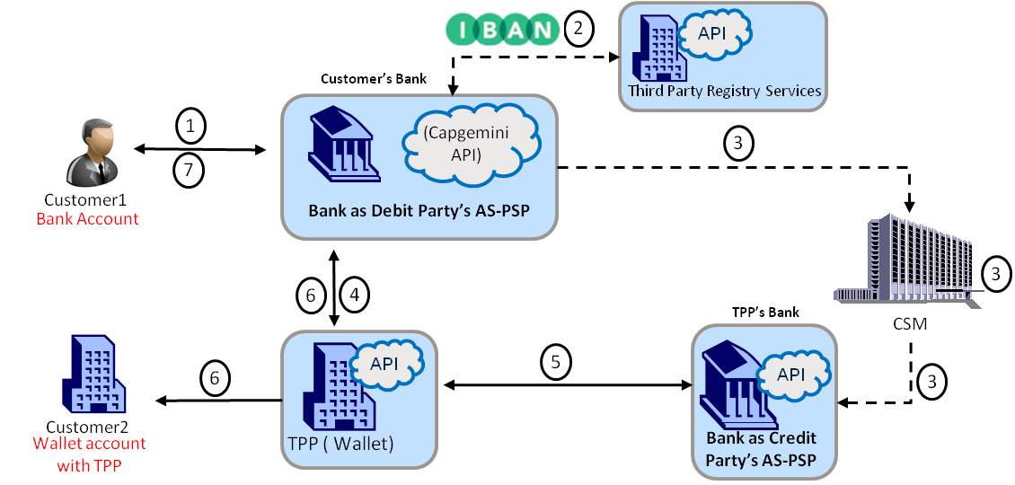
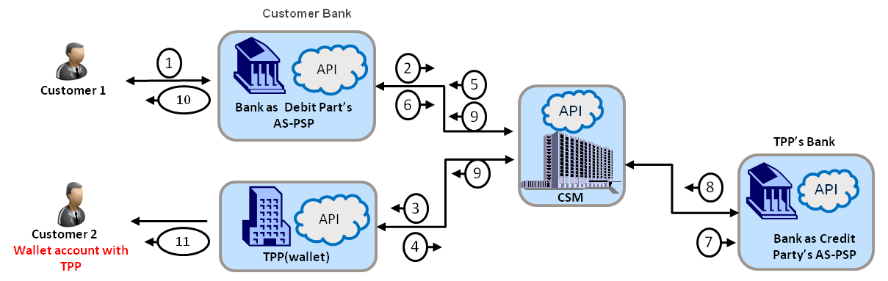
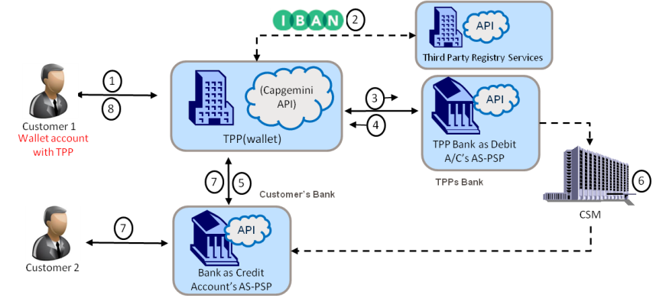
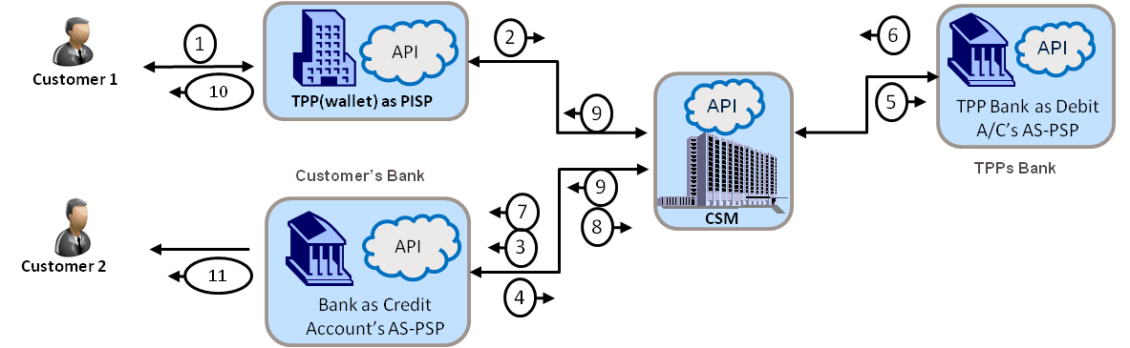
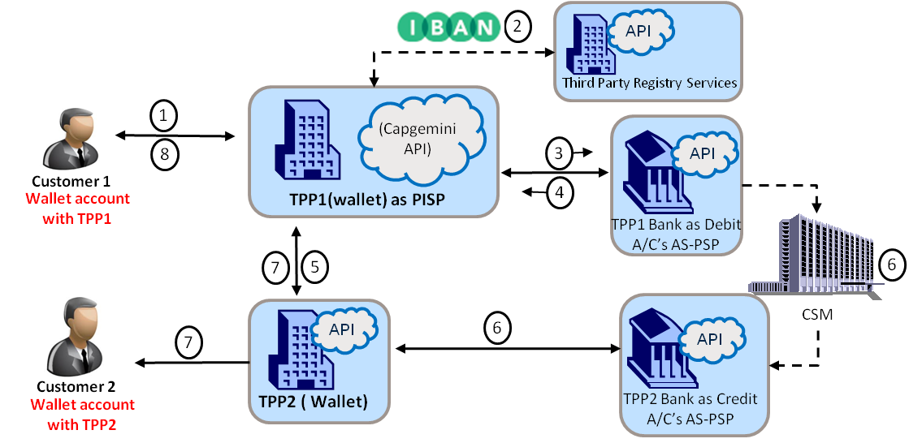
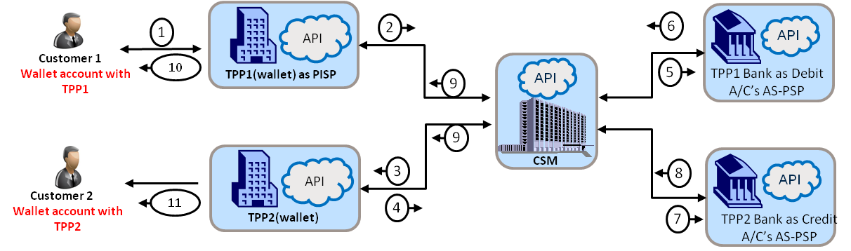
Snapshot of Business Scenarios for Banks acting as AS-PSP to be competitive in post-PSD2 ecosystem
Scenario 4
Scenario 4.1
Pacs.008
Pacs.010
Pacs.008
Camt.054
Bank to TPP
Pacs.002
Pain.002
Camt.060 – request
Camt.052/53 - response
Pain.002
Pacs.002
Pacs.002
Camt.054
OR
Camt.060
Pain.002
Camt.054
Camt.054
Pacs.008
Camt.052
Pacs.009
Scenario 5
Camt.060 – request
Camt.052/53 - response
Pacs.008
Pacs.002
Pain.001
Pacs.008
Camt.054
Pain.002
TPP to Bank
Pain.002
OR
Scenario 5.1
Pacs.009
Pacs.002
Pacs.002
Pain.002
Pacs.010
Camt.052
Pacs.002
Camt.060
Camt.054
Pacs.008
Camt.052
Scenario 6
Camt.060 – request
Camt.052/53 - response
Pacs.008
Pacs.002
Camt.054
Pain.001
Pacs.008
TPP to TPP
OR
Pain.002
Scenario 5.1
Pacs.010
Pacs.002
Pacs.002
Pain.002
Camt.052
Pacs.002
Camt.060
Camt.054
Pacs.008
Camt.052
Pacs.009
Note: the reason for adding OR scenario is because future scenarios are dependent on CSM’s implementation approach which is yet to be decided

Slide 11
Functionalities/APIs for Bank to TPP, TPP to Bank & TPP to TPP interaction
Reference Scenario 4: Based on limited information provided in EBA published Paper on PSD2.
getCreditAlias
checkCustomerCreditDetails
executePaymentOrder
getIBAN
notifyPaymentOrderStatus
sendPaymentInfo
notifyPaymentSentToCustomer
notifyPaymentReceiptToTPP
Reference Scenario 4.1: Based on Australian NPP and India UPI Approach
getLoginDetails
executePaymentOrder
sendPaymentInitiationRequest
debitResponse
notifyPaymentSentToCustomer
creditResponse
Reference Scenario 4: Based on limited information provided in EBA published Paper on PSD2.
checkCustomerCreditDetails
executePaymentOrder
matchTransaction
notifyPaymentOrderStatusToTPP
notifyPaymentReceiptToTPP
notifyPaymentReceiptToCustomer
Reference Scenario 5.1: Based on Australian NPP and India UPI Approach
responseToVerifyCreditCustomer
creditResponse
notifyPaymentReceiptToCustomer
debitResponse
Reference Scenario 6: Based on limited information provided in EBA published Paper on PSD2.
checkCustomerCreditDetails
executePaymentOrder
notifyPaymentOrderStatus
notifyPaymentReceiptToTPP
Scenario 6.1: Based on Australian NPP and India UPI Approach
debitResponse
creditResponse
Scenario 4, 4.1, 5, 5.1, 6, 6.1: Based on Australian NPP and India UPI model and on limited provided in EBA published paper and some functional assumptions.
sendIBANDetails
verifyCreditCustomer
debitRequest
creditRequest
notifyCreditStatus
notifyDebitStatus
Scenario 4, 5, 6
matchTransaction
getCreditAlias
notifyPaymentStatusToBank
notifyPaymentReceiptToCustomer
getIBAN
sendPaymentInitiationRequest
sendPaymentInfo
notifyPaymentSentToCustomer
notifyPaymentStatusToTPP
Scenario 4.1, 5.1, 6.1
getLoginDetails
executePaymentOrder
sendPaymentInitiationRequest
notifyPaymentSentToCustomer
responseToVerifyCreditCustomer
notifyPaymentReceiptToCustomer
APIs/Functionality for CSM / Third Party Registry Service
APIs/Functionality for Wallet acting as Third Party Provider
APIs/ Functionality for Banks
Note: Functionalities/APIs are covered in detail in subsequent slides

Slide 12
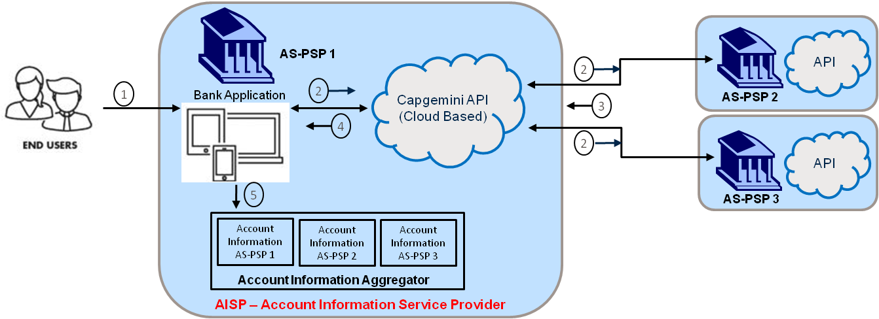
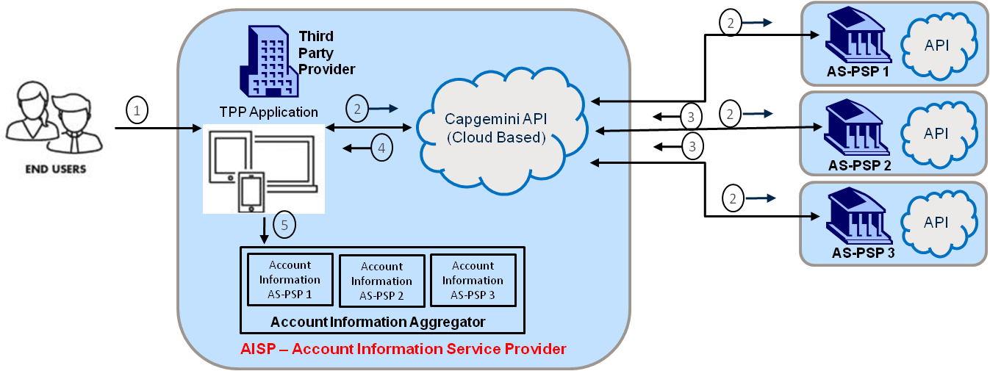
Snapshot of Business Scenarios for Bank/TPP acting as AISP & Bank acting as AS-PSP to comply with PSD2 regulations
Banks can opt not to play AISP role immediately but it still has to implement AS-PSP functionality to respond the AISPs. Effectively AS-PSP role becomes mandatory for Banks
Camt.060
getAccountInfoResponse
showAccountInfo
getAccountInfoRequest
Camt.052
Camt.052
Camt.060
APIs/Functionality for AISP
Scenario 7
Camt.060
verifyAccountInfoRequest
SendAccountInfo
APIs/Functionality for AS-PSP
Note: This is Mandatory for Banks to be PSD2 Complaint
Camt.052
Camt.052
Camt.060
Scenario 8
Note: the reason for adding OR scenario is because future scenarios are dependent on CSM’s implementation approach which is yet to be decided

Slide 13
Sample PISP Scenarios – Credit Transfer

Slide 14

Scenario 1 – Bank is Acting as PISP using Capgemini API
This scenario is based on existing European Payments system.
E.g. Sofort
5
Customer’s Bank
1. verifyCustomerLoginDetails
2. checkMerchantCreditDetails
3. sendPaymentOTPToCustomer
4. verifyTransactionAndOTPDetails
5. executePaymentOrder
6. notifyPaymentOrderStatus
API
3
4
7
1. getMerchantCreditDetails
2. getMemberState&Bank
3. sendCustomerLoginDetails
4. sendMerchantCreditDetails
5. enterPaymentOTPDetails
6. sendTransactionAndOTPDetails
7. showPaymentsStatus
Customer
6
3rd party Bank
8
Bank as Debit Party’s AS-PSP
(Capgemini API)
10
1
CSM
9
Bank as PISP
API
2
Bank as Credit Party’s AS-PSP
Merchant Website
Static Data: County, Bank and CSM Mapping provider
Merchant Bank
Customer Shop Online on Merchant Website & buy. Customer select “Pay online from Account” option.
Here Bank is acting as PISP using Capgemini API. Capgemini API (Cloud Based) has been invoked for Payment Initiation. getMerchantCreditDetails
Customer has been asked to select “Country/Member State” and “Customer Bank” (AS-PSP). After selecting Country & Bank, Customer needs to enter Login credentials given by their AS-PSP. (Note – PISP will have information about Country & Bank as a part of its Static Data information populated by invoking.) getMemberState&Bank
PISP Sends Payment Initiation request to the Customer Bank for Authorization. sendCustomerLoginDetails, sendMerchantCreditDetails
Customer Bank authorised the Payments details. Customer Bank to generate OTP (One Time Password) & send to customer registered mobile number. (2 factor authorization). verifyCustomerLoginDetails, checkMerchantCreditDetails, sendPaymentOTPToCustomer
Customer received OTP which has been sent by their Bank and enter it in PISP website. enterPaymentOTPDetails
PISP send the OTP details received for the initiated transaction to the Customer Bank. sendTransactionAndOTPDetails
Customer Bank verify the Payment details and OTP. After successful verification, Customer Bank send positive response to the PISP. verifyTransactionAndOTPDetails, executePaymentOrder, notifyPaymentOrderStatus
PISP send control to merchant website and confirms payment status showPaymentStatus
Customer Bank will initiate credit transfer payment to credit Merchant’s account via CSM.
NOTE: Account transfer between Customer and Merchant Bank will be happening with different available CSM’s. E.g. With SEPA Insta Payment it will be real-time fund transfer.
Note: Please be noted, Technical Specification for PSD2 is yet not released by EBA. All the scenario captured is based on certain assumptions and may tend to change.

Slide 15
Scenario 2 – TPP is Acting as PISP using Capgemini API
This scenario is based on existing European Payments system.
E.g. Sofort
5
1. verifyCustomerLoginDetails
2. checkMerchantCreditDetails
3. sendPaymentOTPToCustomer
4. verifyTransactionAndOTPDetails
5. executePaymentOrder
6. notifyPaymentOrderStatus
API
3
4
7
Customer Bank
(AS-PSP)
1. getMerchantCreditDetails
2. getMemberState&Bank
3. sendCustomerLoginDetails
4. sendMerchantCreditDetails
5. enterPaymentOTPDetails
6. sendTransactionAndOTPDetails
7. showPaymentsStatus
Customer
6
8
(Capgemini API)
10
1
CSM
9
TPP as PISP
API
2
Merchant Bank
(AS-PSP)
Merchant Website
Static Data: County, Bank and CSM Mapping provider
Customer Shop Online on Merchant Website & buy. Customer select “Pay online from Account” option.
Here TPP is acting as PISP using Capgemini API. Capgemini API (Cloud Based) has been invoked for Payment Initiation. getMerchantCreditDetails
Customer has been asked to select “Country/Member State” and “Customer Bank” (AS-PSP). After selecting Country & Bank, Customer needs to enter Login credentials given by their AS-PSP. (Note – PISP will have information about Country & Bank as a part of its Static Data information populated by invoking.) getMemberState&Bank
PISP Sends Payment Initiation request to the Customer Bank for Authorization. sendCustomerLoginDetails, sendMerchantCreditDetails
Customer Bank authorised the Payments details. Customer Bank to generate OTP (One Time Password) & send to customer registered mobile number. (2 factor authorization). verifyCustomerLoginDetails, checkMerchantCreditDetails, sendPaymentOTPToCustomer
Customer received OTP which has been sent by their Bank and enter it in PISP website. enterPaymentOTPDetails
PISP send the OTP details received for the initiated transaction to the Customer Bank. sendTransactionAndOTPDetails
Customer Bank verify the Payment details and OTP. After successful verification, Customer Bank send positive response to the PISP. verifyTransactionAndOTPDetails, executePaymentOrder, notifyPaymentOrderStatus
PISP send control to merchant website and confirms payment status showPaymentStatus
Customer Bank will initiate credit transfer payment to credit Merchant’s account via CSM.
NOTE: Account transfer between Customer and Merchant Bank will be happening with different available CSM’s. E.g. With SEPA Insta Payment it will be real-time fund transfer.
Note: Please be noted, Technical Specification for PSD2 is yet not released by EBA. All the scenario captured is based on certain assumptions and may tend to change.

Slide 16
Scenario 2 – TPP is Acting as PISP using Capgemini API
This scenario is based on existing European Payments system.
E.g. Sofort
5
1. verifyCustomerLoginDetails
2. checkMerchantCreditDetails
3. sendPaymentOTPToCustomer
4. verifyTransactionAndOTPDetails
5. executePaymentOrder
6. notifyPaymentOrderStatus
API
3
4
7
Customer Bank
(AS-PSP)
1. getMerchantCreditDetails
2. getMemberState&Bank
3. sendCustomerLoginDetails
4. sendMerchantCreditDetails
5. enterPaymentOTPDetails
6. sendTransactionAndOTPDetails
7. showPaymentsStatus
Customer
6
8
(Capgemini API)
10
1
CSM
9
TPP as PISP
API
2
Merchant Bank
(AS-PSP)
Merchant Website
Static Data: County, Bank and CSM Mapping provider
Customer want to return the product/Service and want full or partial refund andd goes to merchant website and initiates the refund request
Here TPP is acting as PISP using Capgemini API. Capgemini API (Cloud Based) has been invoked for Payment refund.
PISP Sends Payment refund request to the Merchant Bank .
Merchant Bank authorised the Payments details. Merchant Bank to generate OTP (One Time Password) & send to Merchant registered mobile number. (2 factor authorization). verifyCustomerLoginDetails, checkMerchantCreditDetails, sendPaymentOTPToCustomer
Merchant received OTP which has been sent by their Bank and enter it in PISP website. enterPaymentOTPDetails
PISP send the OTP details received for the initiated transaction to the Customer Bank. sendTransactionAndOTPDetails
Customer Bank verify the Payment details and OTP. After successful verification, Customer Bank send positive response to the PISP. verifyTransactionAndOTPDetails, executePaymentOrder, notifyPaymentOrderStatus
PISP send control to merchant website and confirms payment status showPaymentStatus
Customer Bank will initiate credit transfer payment to credit Merchant’s account via CSM.
NOTE: Account transfer between Customer and Merchant Bank will be happening with different available CSM’s. E.g. With SEPA Insta Payment it will be real-time fund transfer.
Note: Please be noted, Technical Specification for PSD2 is yet not released by EBA. All the scenario captured is based on certain assumptions and may tend to change.

Slide 17
Scenario 3 – Merchant is Acting as PISP using Capgemini API
This scenario is based on existing European Payments system.
E.g. Sofort
3
API
List of API
1. verifyCustomerLoginDetails
2. checkMerchantCreditDetails
3. sendPaymentOTPToCustomer
4. verifyTransactionAndOTPDetails
5. executePaymentOrder
6. notifyPaymentOrderStatus
List of API
1. getMerchantCreditDetails
2. getMemberState&Bank
3. sendCustomerLoginDetails
4. sendMerchantCreditDetails
5. enterPaymentOTPDetails
6. sendTransactionAndOTPDetails
7. showPaymentsStatus
Customer
Customer Bank
(AS-PSP)
1
4
6
8
7
CSM
5
(Capgemini API)
2
Merchant Bank
(AS-PSP)
Merchant as PISP
Static Data: County, Bank and CSM Mapping provider
Customer Shop Online on Merchant Website & buy. Customer select “Pay online from Account” option.
Here Merchant is acting as PISP using Capgemini API. Capgemini API (Cloud Based) has been invoked for Payment Initiation. getMerchantCreditDetails
Customer has been asked to select “Country/Member State” and “Bank” (Customer AS-PSP). After selecting Country & Bank, Customer needs to enter Login credentials given by their AS-PSP. Note – Merchant will have information about Country & Bank as a part of its Static Data information populated by invoking getMemberState&Bank
PISP Sends Payment Initiation details to the Customer Bank for Authorization. sendCustomerLoginDetails, sendMerchantCreditDetails
Customer Bank authorised the Payments details. Customer Bank to generate OTP (One Time Password) & send to customer registered mobile number. verifyCustomerLoginDetails, checkMerchantCreditDetails, sendPaymentOTPToCustomer
Customer received OTP which has been sent by their Bank and enter it in PISP website. enterPaymentOTPDetails
PISP send the OTP details received for the initiated transaction to the Customer Bank. sendTransactionAndOTPDetails
Customer Bank verify the Payment details and OTP. After successful verification, Customer Bank send positive response to the PISP. verifyTransactionAndOTPDetails, executePaymentOrder, notifyPaymentOrderStatus
Merchant / PISP confirms payment status on Merchant’s website. sendPaymentStatus
PISP confirms payment status showPaymentStatus
Customer Bank will initiate credit transfer payment to credit Merchant’s account via CSM.
NOTE: Account transfer between Customer and Merchant Bank will be happening with different available CSM’s. E.g. With SEPA Insta Payment it will be real-time fund transfer.
Note: Please be noted, Technical Specification for PSD2 is yet not released by EBA. All the scenario captured is based on certain assumptions and may tend to change.

Slide 18
Scenario 4 – Bank to TPP(Wallet) Money Transfer (Approach 1)
This scenario is based on assumptions and some reference given in the EBA opinion paper
1. getCreditAlias
2. getIBAN
3. checkCustomerCreditDetails
4. executePaymentOrder
5. sendPaymentInfo
6. notifyPaymentSentToCustomer
2
API
1. sendIBANDetails
Third Party Registry Services
1
(Capgemini API)
Assumptions:
1.TPP is wallet
2. Customer1 has account Bank (AS-PSP1)
3. Customer2 has account with TPP
4. TPP maintain Bank Account with AS-PSP2
3
7
Customer1
Customer Bank as PISP
(AS-PSP1)
Bank Account
1. matchTransaction
2. notifyPaymentStatusToBank
3.notifyPaymentReceiptToCustomer
3
6
4
CSM
API
5
API
6
3
Customer2
TPP ( Wallet)
TPP Bank
(AS-PSP2)
1. notifyPaymentReceiptToTPP
Wallet account with TPP
1. Customer1 login into his Online banking portal and initiate credit transfer request to pay Customer2. To initiate payment, Customer1 use “Virtual Address / Alias” of Customer2. getCreditAlias
2. Assuming Third Party Registry Service provider will have “Virtual Address/Alias to it’s Issuer Bank/TPP” mapping, and details of the customer. So Customer1 bank get the IBAN of TPP (Wallet) of Customer2 from authorized Third Party Registry Service. getIBAN, sendIBANDetails
3. Customer1 bank initiate Fund transfer request to credit TPP Bank account via available CSM. checkCustomerCreditDetails, executePaymentOrder
4. On successful payment initiation, Customer1 bank send payment information (Customer2 alias, Transaction Reference, Amount) to TPP (wallet) to credit Customer2. sendPaymentInfo
5. The funds become available to TPP once clearing and settlement in the infrastructure layer has been completed. notifyPaymentReceiptToTPP
6. TPP will match the Customer2 alias, Amount and Transaction Reference and the funds become available to Customer2 in his TPP wallet account. matchTransaction, notifyPaymentStatusToBank, notifyPaymentReceiptToCustomer
7. Customer1 Bank receive the transaction status from TPP and notify the status to Customer1. notifyPaymentSentToCustomer
Note: Please be noted, Technical Specification for PSD2 is yet not released by EBA. All the scenario captured is based on certain assumptions and may tend to change.

Slide 19
Scenario 4.1: Bank to TPP Money Transfer (Approach 2)
This scenario is based on Australian NPP and Indian UPI Payment scheme.
1. getLoginDetails
2. executePaymentOrder
3. sendPaymentInitiationRequest
4. debitResponse
5.notifyPaymentSentToCustomer
1. verifyCreditCustomer
2. debitRequest
3. creditRequest
4. notifyCreditStatus
Customer Bank
1
API
2
Customer 1
10
5
Bank as Debit Part’s AS-PSP
6
9
API
1. responseToVerifyCreditCustomer
2. notifyPaymentReceiptToCustomer
TPP’s Bank
9
8
API
API
3
CSM
1. creditResponse
Customer 2
11
4
7
Bank as Credit Party’s AS-PSP
Wallet account with TPP
TPP(wallet)
1. Customer1 login to his Online Bank account portal and initiates transaction to credit to Customer2’s TPP (Wallet) account. To initiate payment, Customer1 use Virtual Address (Mobile Number, Email Address or Any customized address) of Customer2. This virtual address is generated by TPP and provided to customer2. Mapping of Virtual Address to TPP/Bank is present with CSM so that CSM uniquely identified the customer’s TPP/Bank. getLoginDetails
2. Bank send payment initiation request to CSM for Processing. executePaymentOrder , sendpaymentInitiationrequest
3. CSM identify Customer2’s TPP(Wallet) and send request to verify if the Customer2 with given Virtual Address is valid customer or not. verifyCreditCustomer
4. TPP get request from CSM and verify the Customer2 details and give positive response to CSM. responseToVerifyCreditCustomer
5. Based on the +ve, -ve response received, CSM send the debit request (Debit Customer1 account maintain with Bank). debitRequest
6. Customer1 Bank authenticates request and debits Customer1 account and send debit response to CSM. Bank notifies to Customer1. . debitResponse, notifyPaymentSentToCustomer
7. CSM sends the Credit request to the TPP’s Bank to credit TPP account. creditRequest
8. TPP bank credit TPP account and send credit response to CSM. creditResponse
9. CSM sends Credit Confirmation details to TPP (wallet). notifyCreditStatus
10. TPP credit Customer2 TPP (wallet account) and notifies to Customer2. notifyPaymentReceiptToCustomer
Note: Please be noted, Technical Specification for PSD2 is yet not released by EBA. All the scenario captured is based on certain assumptions and may tend to change.

Slide 20
Scenario 5 –TPP to Bank Money Transfer (Approach 1)
This scenario is based on assumptions and some reference given in the EBA opinion paper
1. getCreditAlias
2. getIBAN
3. sendPaymentInitiationRequest
4. sendPaymentInfo
5. notifyPaymentSentToCustomer
2
API
1. sendIBANDetails
Third Party Registry Services
1. checkCustomerCreditDetails,
2. executePaymentOrder
3. notifyPaymentOrderStatus
1
(Capgemini API)
3
API
8
Customer 1
4
Wallet account with TPP
TPP(wallet)
TPP Bank as Debit A/C’s AS-PSP
1. matchTransaction
2. notifyPaymentReceiptToTPP
3. notifyPaymentReceiptToCustomer
6
7
5
TPPs Bank
Customer’s Bank
API
CSM
7
Customer 2
Bank as Credit Account’s AS-PSP
1. Customer1 login into his TPP (wallet) portal and initiate credit transfer request to pay Customer2. To initiate payment, Customer1 use “Virtual Address / Alias” of Customer2. getCreditAlias
2. Assuming Third Party Registry Service provider will have “Virtual Address/Alias to it’s Issuer Bank/TPP” mapping, and details of the customer. So TPP get the IBAN of Beneficiary customer’s Bank from authorized Third Party Registry Service. getIBAN, sendIBANDetails
3. TPP send credit transfer initiation request to TPP’s Bank (AS-PSP1). sendPaymentInitiationRequest
4. AS-PSP1 send positive response to TPP for initiated credit transfer request. checkCustomerCreditDetails, executePaymentOrder, notifyPaymentOrderStatus
5. On positive acknowledgement from AS-PSP1 (TPP Bank), TPP send Customer2’s “Virtual Address / Alias”, “Amount” and “Transaction Reference Number” to Customer2’bank. sendPaymentInfo
6. The funds become available to Customer2’s bank once clearing and settlement in the infrastructure layer has been completed.
7. Customer2’s Bank will match the Customer2 alias, Amount and Transaction Reference and the funds become available to Customer2 in his bank account. matchTransaction, notifyPaymentStatusToTPP, notifyPaymentReceiptToCustomer
8. Customer1’s TPP receive the transaction status from Customer2’s Bank and notify the status to Customer1. notifyPaymentSentToCustomer
Note: Please be noted, Technical Specification for PSD2 is yet not released by EBA. All the scenario captured is based on certain assumptions and may tend to change.

Slide 21
Scenario 5.1 –TPP to Bank Money Transfer (Approach 2)
This scenario is based on Australian NPP and Indian UPI Payment scheme.
1. getLoginDetails
2. executePaymentOrder
3. sendPaymentInitiationRequest
4. notifyPaymentSentToCustomer
1. verifyCreditCustomer
2. debitRequest
3. creditRequest
4. notifyDebitStatus
API
2
6
API
1. debitResponse
1
Customer 1
10
API
Wallet account with TPP
TPP(wallet) as PISP
9
5
TPP Bank as Debit A/C’s AS-PSP
1. responseToVerifyCreditCustomer
2. creditResponse
3. notifyPaymentReceiptToCustomer
Customer’s Bank
9
TPPs Bank
7
8
CSM
API
3
Customer 2
11
Bank as Credit Account’s AS-PSP
4
1. Customer1 login to his TPP (Wallet) account and initiates transaction to credit to Customer2’s Bank account. To initiate payment Customer1 use Virtual Address (Mobile Number, Email Address or Any customized address) of Customer2. This virtual address is generated by Customer2’s Bank and provided to customer2. Mapping of Virtual Address to TPP/Bank is present with CSM so that CSM uniquely identified the customer’s TPP/Bank. getLoginDetails
2. TPP send payment initiation request to CSM for Processing. executePaymentOrder , sendpaymentInitiationrequest
3. CSM identify Customer2’s Bank and send request to verify if the Customer2 with given Virtual Address is valid customer or not. verifyCreditCustomer
4. Customer2’s Bank get request from CSM and verify the Customer2 details and give positive response to CSM. responseToVerifyCreditCustomer
5. Based on the +ve, -ve response received, CSM send the debit request (Debit TPP account maintain with Bank(AS-PSP1)). debitRequest
6. TPP’s Bank authenticates request and debits TPP account and send debit response to CSM. debitResponse
7. CSM sends the Credit request to the Customer2’s Bank to credit Customer2 account. creditRequest
8. Customer2 bank credit Customer2 account and send credit response to CSM. creditResponse, notifyPaymentReceiptToCustomer
9. CSM Sends Debit Confirmation details to TPP (wallet). notifyDebitStatus
10. TPP notifies to Customer1. notifyPaymentSentToCustomer
Note: Please be noted, Technical Specification for PSD2 is yet not released by EBA. All the scenario captured is based on certain assumptions and may tend to change.

Slide 22
Scenario 6: TPP1 as PISP - Money Transfer to TPP2(Cross TPP/Wallet)
This scenario is based on assumptions and some reference given in the EBA opinion paper
1. getCreditAlias
2. getIBAN
3. sendPaymentInitiationRequest
4. sendPaymentInfo
5. notifyPaymentSentToCustomer
2
API
1. sendIBANDetails
Third Party Registry Services
1
(Capgemini API)
1. checkCustomerCreditDetails,
2. executePaymentOrder
3. notifyPaymentOrderStatus
8
3
API
Customer 1
4
Wallet account with TPP1
TPP1(wallet) as PISP
Assumptions:
1.TPP1 & TPP2 is wallet
2. Customer1 has account with TPP1
3. TPP1 maintain Bank Account with AS-PSP1
4. Customer2 has account with TPP2
5. TPP2 maintain Bank Account with AS-PSP2
TPP1 Bank as Debit A/C’s AS-PSP
1. matchTransaction
2. notifyPaymentStatusToTPP
3.notifyPaymentReceiptToCustomer
6
7
5
API
6
CSM
7
API
Customer 2
TPP2 ( Wallet)
TPP2 Bank as Credit A/C’s AS-PSP
1. notifyPaymentReceiptToTPP2
Wallet account with TPP2
1. Customer1 login into his TPP1 (wallet) portal and initiate credit transfer request to pay Customer2. To initiate payment Customer1 use “Mobile Number OR Email Address” of Customer2 and “TPP2” name. getCreditAlias
2. Assuming Third Party Registry Service provider will have “Virtual Address/Alias to it’s Issuer Bank/TPP” mapping, and details of the customer . So TPP1 get the IBAN of TPP2 from authorized Third Party Registry Service. getIBAN, sendIBANDetails
3. TPP1 send credit transfer initiation request to TPP1’s Bank (AS-PSP1). sendPaymentInitiationRequest
4. AS-PSP1 send positive response to TPP1 for initiated credit transfer request. checkCustomerCreditDetails, executePaymentOrder, notifyPaymentOrderStatus
5. On positive acknowledgement from AS-PSP1 (TPP1 Bank), TPP1 send Customer2’s “Virtual Address / Alias”, “Amount” and “Transaction Reference Number” to TPP2. sendPaymentInfo
6. The funds become available to TPP2 once clearing and settlement in the infrastructure layer has been completed. notifyPaymentReceiptToTPP2
7. TPP2 will match the Receiver and Transaction details and the funds become available to Customer2 in his TPP2 wallet account. matchTransaction, notifyPaymentStatusToTPP1, notifyPaymentReceiptToCustomer
8. TPP1 receive the transaction status from TPP2 and TPP1 notify the status to customer1. notifyPaymentSentToCustomer
Note: Please be noted, Technical Specification for PSD2 is yet not released by EBA. All the scenario captured is based on certain assumptions and may tend to change.

Slide 23
Scenario 6.1: TPP1 as PISP - Money Transfer to TPP2 (Cross TPP/Wallet)
This scenario is based on Australian NPP and Indian UPI Payment scheme.
1. getLoginDetails
2. executePaymentOrder
3. sendPaymentInitiationRequest
4. notifyPaymentSentToCustomer
1. verifyCreditCustomer
2. debitRequest
3. creditRequest
4. notifyDebitStatus
5. notifyCreditStatus
API
2
6
API
1. debitResponse
1
Customer 1
10
API
5
TPP1 Bank as Debit A/C’s AS-PSP
Wallet account with TPP1
TPP1(wallet) as PISP
9
1. responseToVerifyCreditCustomer
2. notifyPaymentReceiptToCustomer
9
API
3
CSM
8
API
1. creditResponse
Customer 2
11
4
Wallet account with TPP2
TPP2(wallet)
7
TPP2 Bank as Credit A/C’s AS-PSP
1. Customer1 login to his TPP1 (Wallet) account and initiates transaction to credit to Customer2’s TPP 2 (Wallet) account. To initiate payment Customer1 use Virtual Address (Mobile Number, Email Address or Any customized address) of Customer2. This virtual address is generated by TPP2 and provided to customer2. Mapping of Virtual Address to TPP/Bank is present with CSM so that CSM uniquely identified the customer’s TPP/Bank. getLoginDetails,
2. TPP1 send payment initiation request to CSM for Processing. executePaymentOrder, sendpaymentInitiationrequest
3. CSM identify Customer2’s TPP/Wallet and send request to verify if the Customer2 with given Virtual Address is valid customer or not. verifyCreditCustomer
4. TPP2 get request from CSM and verify the Customer2 details and give positive response to CSM. responseToVerifyCreditCustomer
5. Based on the +ve, -ve response received, CSM send the debit request t (Debit TPP1 account maintain with Bank). debitRequest
6. TPP1 Bank authenticates request and debits TPP1 account and send debit response to CSM. debitResponse
7. CSM sends the Credit request to the TPP2 Bank to credit TPP2 account. creditRequest
8. TPP2 bank credit TPP2 account and send credit response to CSM. creditResponse
9. CSM Sends Debit Confirmation details to TPP1 (wallet). CSM sends Credit Confirmation details to TPP2 (wallet). notifyDebitStatus, notifyCreditStatus
10. TPP1 notifies to Customer1. notifyPaymentSentToCustomer
11. TPP2 credit Customer2 TPP (wallet account) and notifies to Customer2. notifyPaymentReceiptToCustomer
Note: Please be noted, Technical Specification for PSD2 is yet not released by EBA. All the scenario captured is based on certain assumptions and may tend to change.

Slide 24
AISP Scenarios

Slide 25


Scenario 7 – Bank is Acting as AISP using Capgemini API
This scenario is Based on limited information provided in EBA published Paper on PSD2..
AS-PSP 1
API
Capgemini API
(Cloud Based)
2
1.verifyAccountInfoRequest
2. sendAccountInfo
1
Bank Application
2
3
AS-PSP 2
4
2
API
1.verifyAccountInfoRequest
2. sendAccountInfo
5
AS-PSP 3
Account Information
AS-PSP 1
Account Information
AS-PSP 2
Account Information
AS-PSP 3
List Of API
getAccountInfoRequest
getAccountInfoResponse
showAccountInfo
Account Information Aggregator
AISP – Account Information Service Provider
Customer / End User logged in to Online Banking environment using login credentials for AS-PSP 1 and access AISP service provided by Bank (AS-PSP 1) to check account information for the accounts held with other banks (AS-PSP2 and AS-PSP 3)
AS-PSP 1 invokes Capgemini API (Cloud Based) to get account information details from AS-PSP 2 and AS-PSP 3. getAccountInfoRequest
AS-PSP 2 & AS-PSP 3 has verified the request by AS-PSP 1 and send account information to AS-PSP 1. verifyAccountInfoRequest, sendAccountInfo
Note: there will be preset mandate given by end user which authorises AS-PSP 1 to pull his account information.
AS-PSP 1 get account information from AS-PSP 2 & AS-PSP 3 in pre-agreed format. getAccountInfoResponse
AS-PSP 1 show account information for AS-PSP 1, AS-PSP 2 & AS-PSP 3. showAccountInfo
Assumptions:
1. Bank/TPP acting as a AISP is authorized to ask for Customer account Information based on Customer request.
2. AS-PSP (Bank) is liable to provide customer account information to AISP (Bank/TPP) in pre-agreed format as per customer request.
Note: Please be noted, Technical Specification for PSD2 is yet not released by EBA. All the scenario captured is based on certain assumptions and may tend to change.

Slide 26
Scenario 8 – TPP is Acting as AISP using Capgemini API
This scenario is Based on limited information provided in EBA published Paper on PSD2..
Third Party Provider
2
API
1.verifyAccountInfoRequest
2. sendAccountInfo
Capgemini API
(Cloud Based)
AS-PSP 1
1
TPP Application
2
3
2
API
1.verifyAccountInfoRequest
2. sendAccountInfo
4
3
AS-PSP 2
2
API
1.verifyAccountInfoRequest
2. sendAccountInfo
5
Account Information
AS-PSP 1
Account Information
AS-PSP 2
Account Information
AS-PSP 3
AS-PSP 3
List Of API
getAccountInfoRequest
getAccountInfoResponse
showAccountInfo
Account Information Aggregator
AISP – Account Information Service Provider
Customer / End User logged in to TPP Application using login credentials given by TPP and access AISP services provided by TPP to check account information for the accounts held with other banks (AS-PSP1 and AS-PSP 2)
TPP invokes Capgemini API (Cloud Based) to get account information details from AS-PSP 1 and AS-PSP 2. getAccountInfoRequest
AS-PSP 1, AS-PSP 2 & AS-PSP 3 has verified the request by TPP and send account information to TPP. verifyAccountInfoRequest, sendAccountInfo
Note: there will be preset mandate given by end user which authorises AS-PSP 1 to pull his account information.
TPP get account information from AS-PSP 1, AS-PSP 2 & AS-PSP 3 in pre-agreed format. getAccountInfoResponse
TPP show account information for AS-PSP 1, AS-PSP 2 & AS-PSP 3. showAccInfo
Assumptions:
1. Bank/TPP acting as a AISP is authorized to ask for Customer account Information based on Customer request.
2. AS-PSP (Bank) is liable to provide customer account information to AISP (Bank/TPP) in pre-agreed format as per customer request.
Note: Please be noted, Technical Specification for PSD2 is yet not released by EBA. All the scenario captured is based on certain assumptions and may tend to change.

Slide 27
PISP Scenarios for PSD2 - Direct Debit

Slide 28


Scenario 9 – Mandate Setup for Direct Debit Mandate management by Merchant Bank
This use case is loosely based on the model followed by the following sample fintechs:
NuaPay and SynapsePay
Strong Customer Authentication/ OTP
Camt.060 – request
Camt.052/53 - response
5
Camt.036
Customer’s Bank
Note: Direct Debit Payment flow is not covered as it is BAU process initiated by Merchant Bank
Static Data: County, Bank and CSM Mapping provider
API
3
4
7
Buyer/Debtor
3rd party Bank
Bank as Debit Party’s AS-PSP
9
Strong Customer Authentication/ OTP
Camt.036
(Capgemini API)
6
1
Pain.009
Pain.002
11
Bank as PISP
2
7
API
10
Pain.009
API
3.1
Bank as Credit Party’s AS-PSP
Pain.009
Merchant/Creditor
Third Party Registry Services
Camt.060 – request
Camt.052/53 - response
Merchant Bank
For Real account/IBAN derivations
Merchant sends the mandate form to Buyer; Buyer fills necessary details.
Buyer signs the mandate using electronic signature and the Merchant sends it to the PISP. getMandateDetails
PISP will verify the customer bank i.e. AS-PSP to which the mandate has to be sent. (Note – PISP will have information about Country & Bank as a part of its Static Data information populated ) getMemberState&Bank
3.1 Optional step : PISP refers the registry services to derive the actual account number/IBAN and agent bank based on virtual address. sendIAcctNBankDetails
PISP sends the updated (With real account details) mandate to the customers bank for authorization.
Customer bank initiates the SCA process with the Buyer.
The Buyer enters the SCA security credentials and the data is sent to the Merchant which sends it to the PISP.
PISP send the SCA security details received for the initiated transaction to the Customer Bank. sendTransactionAndOTPDetails
Customer Bank verify the Payment details and OTP. After successful verification, Customer Bank send positive response to the PISP. verifyTransactionAndOTPDetails, executePaymentOrder, notifyPaymentOrderStatus
Approval for E-Mandate is sent by the Customer’s Bank to the PISP..
Approved e-mandate is sent from PISP to Merchant’s bank to safe store it. Merchant`s bank should act as a mandate manager.
Merchant bank shares a copy of the mandate with Customer bank.
NOTE: All the information has to be sent through EBICS.

Slide 29
Scenario 9.1 – Mandate Setup for Direct Debit Mandate is maintained and managed by PISP
This is an alternate flow envisaged in a post PSD2 scenario, currently this flow does not exist
Strong Customer Authentication/ OTP
Camt.060 – request
Camt.052/53 - response
5
Camt.036
Customer’s Bank
Mandate Setup flow
API
Pacs.003
DD payment flow
Static Data: County, Bank and CSM Mapping provider
3
4
8
11
Buyer/Debtor
3rd party Bank
Bank as Debit Party’s AS-PSP
(Capgemini API)
9
Strong Customer Authentication/ OTP
6
1
Camt.036
Pain.009
Pain.002
CSM
7
Bank as PISP
API
11
2
10
Pacs.003
Pain.009
API
Bank as Credit Party’s AS-PSP
3.1
Pain.008
Merchant/Creditor
Merchant Bank
Third Party Registry Services
Camt.060 – request
Camt.052/53 - response
For Real account/IBAN derivations
Merchant sends the mandate form to Buyer; Buyer fills necessary details.
Buyer signs the mandate using electronic signature and the Merchant sends it to the PISP. getMandateDetails
PISP will verify the customer bank i.e. AS-PSP to which the mandate has to be sent. (Note – PISP will have information about Country & Bank as a part of its Static Data information populated ) getMemberState&Bank
3.1 Optional step : PISP refers the registry services to derive the actual account number/IBAN and agent bank based on virtual address. sendIAcctNBankDetails
PISP sends the updated (With real account details) mandate to the customers bank for authorization.
Customer bank initiates the SCA process with the Buyer.
The Buyer enters the SCA security credentials and the data is sent to the Merchant which sends it to the PISP.
PISP send the SCA security details received for the initiated transaction to the Customer Bank. sendTransactionAndOTPDetails
Customer Bank verify the Payment details and OTP. After successful verification, Customer Bank send positive response to the PISP. verifyTransactionAndOTPDetails, executePaymentOrder, notifyPaymentOrderStatus
Approval for E-Mandate is sent by the Customer’s Bank to the PISP.
The approved e-mandate is safe-stored at the PISP which acts as a Mandate Manager. On the day of Direct Debit, the PISP sends a PAIN 008 message to the Merchant’s AS-PSP.
On receiving the PAIN 008 message, the Merchant’s Bank sends PACS 003 message to the Customer’s Bank through the CSM
NOTE: All the information has to be sent through EBICS.

Slide 30
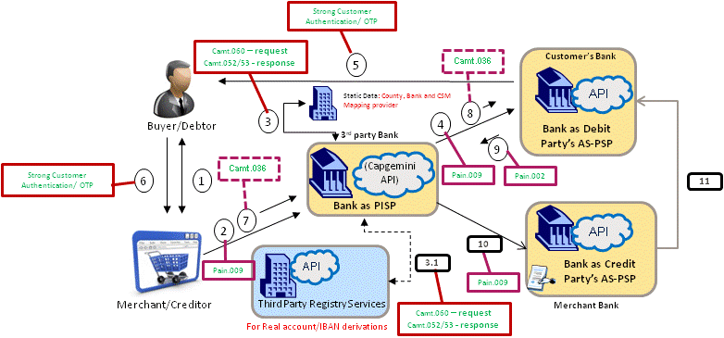
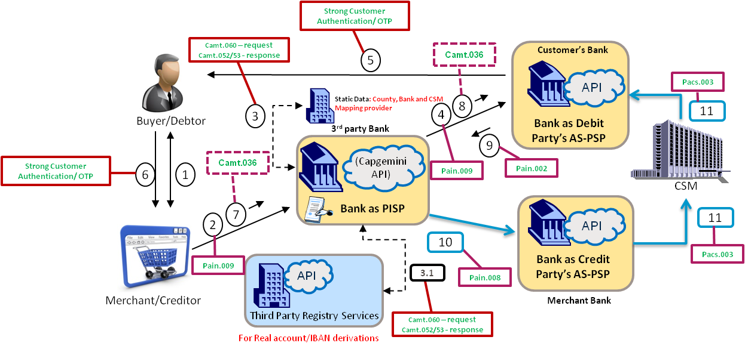
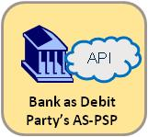
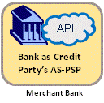
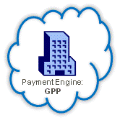
Direct Debit flow integrated with Payments Engine (GPP)
3rd party Bank
3rd party Bank
On receiving Pain.008 Merchant Bank is expected to follow BAU process for Direct debit i.e. it will send Pacs.003 (IDF) to CSM for Customer’s bank
(Capgemini API)
(Capgemini API)
Pain.008
Bank as PISP
Bank as PISP
Customer Bank
Pain.009
Pain.009
PISP will initiate Pain.008 at predefined time interval as per mandate
GPP Service: MandateService
GPP Service: MandateService
GPP Service: MessageSubmitService
Payment Engine: GPP
Note: In case we do not want to leverage Payment engine’s DD workflow, Capgemini’s API platform will have to develop entire DD flow and associated APIs/Functionalities e.g. receiving Pain.008, transforming and forwarding Pacs.003, R-Message handling etc.
Note for PISP: Safe storing temporarily for Scenario 9 and permanent storage for scenario 9.1

Slide 31
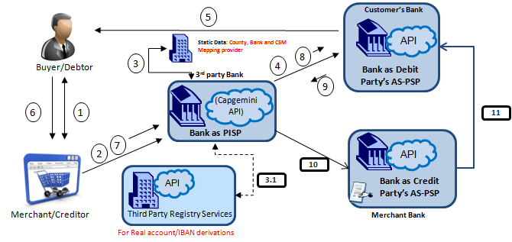
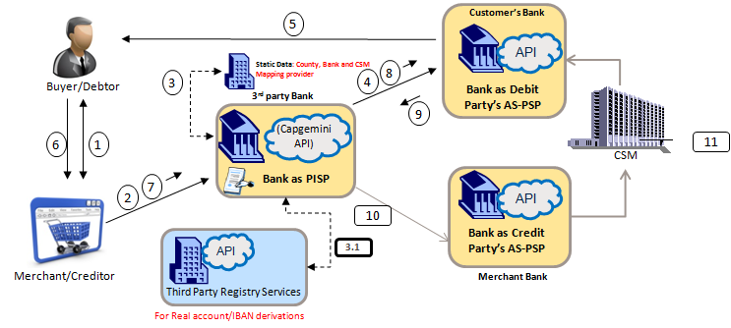
Snapshot of Business Scenarios for Banks/TPP acting as PISP for Direct Debit to comply with PSD2 regulations
All Banks has to implement these for it to be PSD2 compliant
Scenario 9 - Mandate Setup for Direct Debit - Mandate is maintained and managed by Merchant Bank
Mandatory Functionality/APIs from Customer’s Bank
verifyTransactionAndOTPDetails
executePaymentOrder
notifyPaymentOrderStatus
showPaymentsStatus
Scenarios to handle PISP request
Functionality/APIs from PISP
getMandateDetails
getMemberState&Bank
sendIAcctNBankDetails
sendTransactionAndOTPDetails
sendTransactionAndOTPDetails
Either one of these 2 Scenarios are mandatory Scenarios that every bank or TTP that wants to play the role of PISP for Direct Debit has to cover under PSD2.
Scenario 9.1 - Mandate Setup for Direct Debit - Mandate is maintained and managed by PISP
Note: Functionalities/APIs are covered in detail in subsequent slides

